Slide 1
Section 9.6
Infinite Series:
“Alternating Series; Absolute and Conditional Convergence”

Slide 2
All graphics are attributed to:
Calculus,10/E by Howard Anton, Irl Bivens, and Stephen Davis Copyright © 2009 by John Wiley & Sons, Inc. All rights reserved.”

Slide 3
Introduction
Until now, we have focused only on series with nonnegative terms.
In this section, we will discuss series that contain both positive and negative terms.

Slide 4
Alternating Series
Series whose terms alternate between positive and negative terms are called alternating series.
Alternating series are of special importance.
They generally have one of the following two forms:
NOTE: The $a_{k}s$ are assumed to be positive in both cases.

Slide 5
Alternating Series Test
NOTES:
It is not necessary for condition (a) to hold for all terms. An alternating series will converge as long as condition (b) is true and condition (a) holds eventually.
If an alternating series violates condition (b), then the series must diverge by the divergence test.
Unlike the Integral Test and the Comparison/Limit Comparison Test, this test will only tell us when a series converges and not if a series will diverge

Slide 6
Proof of the Alternating Series Test
You do not need to copy this down. Just read it and look at the diagram so that we can discuss it.
This proof is only for type (1) alternating series:
The idea is to show that if conditions (a) and (b) hold, then the sequence of even-numbered and odd-numbered partial sums converge to a common limit S.

Slide 7
Proof of the Alternating Series Test (continued)
The even-numbered partial sums $s_{2 },s_{4},s_{6},…,s_{2n}$,… form an increasing sequence bounded above by $a_{1}$ (right) that we will call a limit $S_{E}$.
The odd-numbered partial sums $s_{1},s_{3},s_{5},…,s_{2n−1},…$ form a decreasing sequence bounded below by 0 that we will call a limit $S_{O(odd)}$.
We must prove that these two limits are equal.

Slide 8
Proof of the Alternating Series Test (continued)
We now know that $s_{2n}$ is an increasing sequence that is bounded above and so we know that it must also converge. So, let’s assume that its limit is $S_{E}$ or, $\lim_{n→∞}{s_{2n}}=$ $S_{E}$.
Next, we can determine the limit of the sequence of odd partial sums, $s_{2n−1}$ .
$\lim_{n→∞}{s_{2n−1}}=$ $\lim_{n→∞}({s_{2n}}+−a_{2n})=\lim_{n→∞}{s_{2n}}+\lim_{n→∞}{a_{2n}}=$ $S_{E}$ + 0 = $S_{E}$ where
$−a_{2n}$ is the last term in the even-numbered sequence.
So, we now know that both $s_{2n}$ and $s_{2n−1}$ are convergent sequences and they both have the same limit and so we also know that $s_{n}$ is a convergent sequence with a limit of s. This in turn tells us that $\sum{a_{n}}$ is convergent.

Slide 9
Example 1
Determine if the following series is convergent or divergent $\sum_{k=1}^{∞}{\frac{{(−1)}^{k+1}}{k}}$
Solution
First, identify the a_{k} for the test.
$\sum_{k=1}^{∞}{\frac{{(−1)}^{k+1}}{k}}$ = $\sum_{k=1}^{∞}{{(−1)}^{k+1}\frac{1}{k}}$ which is form 1 and a_{k} = $\frac{1}{k}$
Now, all that we need to do is run through the two conditions in the test.
a_{k} = $\frac{1}{k}$ > $\frac{1}{k+1}=$ a_{k+1} and $\lim_{k→+∞}{\text{a}\text{k}}=$ $\lim_{k→+∞}{\frac{1}{k}}=0$
Both conditions are met and so by the Alternating Series Test the series must converge.
NOTE: This is the alternating harmonic series which converges even though the harmonic series itself diverges.

Slide 10
Example 2
Determine if the following series is convergent or divergent $\sum_{k=1}^{∞}{{(−1)}^{k+1}\frac{k+3}{k(k+1)}}$
Solution
First, identify the a_{k} for the test:$\sum_{k=1}^{∞}{{(−1)}^{k+1}\frac{k+3}{k(k+1)}}$ form 1 and a_{k} = $\frac{k+3}{k(k+1)}$
Now, all that we need to do is run through the two conditions in the test.
Condition (a): a_{k} = $\frac{k+3}{k(k+1)}$ and a_{k+1} $\frac{k+4}{(k+1)(k+2)}$.
Thus $\frac{\text{a}\text{k}\text{+1}}{\text{a}\text{k}}$ = $\frac{\frac{k+4}{(k+1)(k+2)}}{\frac{k+3}{k(k+1)}}=\frac{k+4}{(k+1)(k+2)} ∗\frac{k(k+1)}{k+3}= \frac{k^{2}+4k}{k^{2}+5k+6}=\frac{k^{2}+4k}{{(k}^{2}+4k)+(k+6)}{<1}$
which tells us that $a_{k}>a_{k+1}$
Condition (b): $\lim_{k→+∞}{\text{a}\text{k}}=\lim_{k→+∞}{\frac{k+3}{k(k+1)}}$ when you divide by the highest power of k in the denominator = 0
Both conditions are met and so by the Alternating Series Test the series must converge.
$$for easier comparison$$

Slide 11
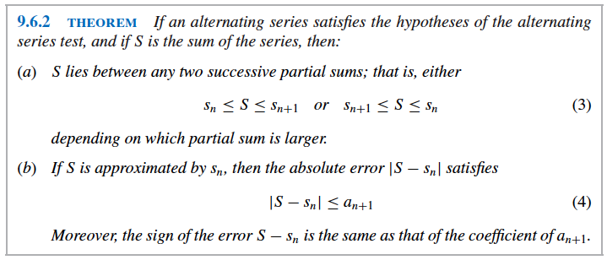
Approximating Sums of Alternating Series
This theorem deals with the error that results when the sum of an alternating series is approximated by a partial sum.

Slide 12
Proof of the Approximating Sums of Alternating Series Theorem
The proof involves the even and odd numbered partial sums like the last proof.
The sign of the error depends on whether n is even or odd since the odd-numbered partial sums are larger than S and the even-numbered partial sums are smaller than S.
See proof on page 640 if you are interested.

Slide 13
Sum of the Alternating Harmonic Series
Later in this chapter, it will be shown that the sum of the alternating harmonic series is ln 2.
For now, see the graph at the right.
Notice that the blue partial sums {$s_{n}\}$approach the red dashed line y = ln 2.

Slide 14
Example of Error Approximation
Find an upper bound on the magnitude of the error that results if ln 2 is approximated by the sum of the first eight terms in the series $\sum_{k=1}^{∞}{{(−1)}^{k+1}\frac{1}{k}}$.
Solution
Using , we get $\left|\ln{2 − s_{8}}\right|$<$a_{9}$ = $\frac{1}{9}$ as an
upper bound.
To check this upper bound on the magnitude of the error,
compute $s﷮8$ = 1 - $\frac{1}{2}$ + $\frac{1}{3}$ - $\frac{1}{4}$ + $\frac{1}{5}$ - $\frac{1}{6}$ + $\frac{1}{7}$ - $\frac{1}{8}$ = $\frac{533}{840}$.
The exact error is $\left|\ln{2 − s_{8}}\right|$ = $\left|\ln{2 −\frac{533}{840}}\right|≈ .059$< $\frac{1}{9}$

Slide 15
Example of Finding a Partial Sum with a Given Accuracy
Find a partial sum that approximates ln 2 to one decimal-place accuracy (the nearest tenth).
Solution
For one decimal-place accuracy, we must choose a value of n for which $\left|\ln{2 − s_{8}}\right|≤.05$ since $\left|\ln{2 − s_{8}}\right|$<$a_{9}$ = $\frac{1}{9}$ $≈ .12$ which has an upper bound error greater than one tenth.
When we actually computed $s﷮8$, we found that the actual error was $≈ .059$ which is accurate to one decimal-place.
Obtaining numerical values for the terms is one approach. Continue until you find the first value that is $≤$ .05.
Another way to find n is to solve the inequality $\frac{1}{n+1}≤ .05$ algebraically.

Slide 16
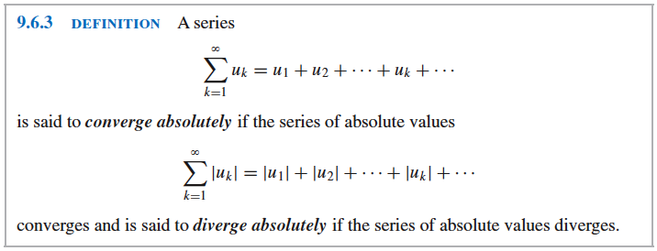
Absolute Convergence
When you encounter a series that does not fit in any of the categories that we have studied so far – mixed signs but not alternating, we need other tests for convergence.

Slide 17
Example of Absolute Convergence
1 - $\frac{1}{2}$ - $\frac{1}{2^{2}}$ + $\frac{1}{2^{3}}$ + $\frac{1}{2^{4}}$ - $\frac{1}{2^{5}}$ - …
converges absolutely since the absolute value of this
series 1 + $\frac{1}{2}$ + $\frac{1}{2^{2}}$ + $\frac{1}{2^{3}}$ + $\frac{1}{2^{4}}$ + $\frac{1}{2^{5}}$ + … is a convergent
geometric series $\left|r\right|$< 1.

Slide 18
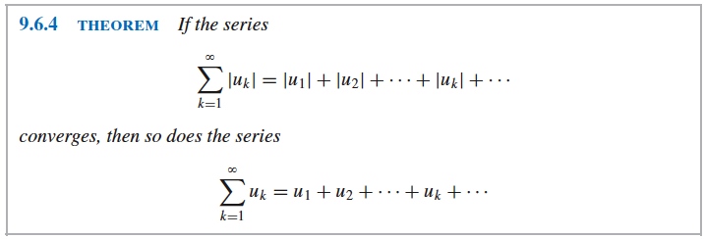
Convergence vs. Absolute Convergence
It is important to distinguish between convergence and absolute convergence.
This theorem provides a way of inferring convergence of a series with positive and negative terms from a related series with nonnegative terms.
This is important because most of the convergence tests that we have developed apply only to series with nonnegative terms.

Slide 19
Example
Show that $\sum_{k=1}^{∞}{\frac{\cos{k}}{k^{2}}}$ converges.
Solution
The graph at the right shows that some of the signs of the terms in this series are negative, but it is not alternating.
Test for absolute convergence $\sum_{k=1}^{∞}{\left|\frac{\cos{k}}{k^{2}}\right|}$ using the comparison test.
$\left|\frac{\cos{k}}{k^{2}}\right|≤\frac{1}{k^{2}}$ which is a convergent p-series (p=2) that converges.
Since the series converges absolutely, it converges.

Slide 20
Conditional Convergence
While Theorem 9.6.4 is a useful tool for series that converge absolutely, it provides no information about the convergence or divergence of a series that diverges absolutely.
Examples
1 - $\frac{1}{2}$ + $\frac{1}{3}$ - $\frac{1}{4}$ + … + ${(−1)}^{k+1}\frac{1}{k}$ + … and -1 - $\frac{1}{2}$ - $\frac{1}{3}$ - $\frac{1}{4}$ -…- $\frac{1}{k}$-…
Both of these diverge absolutely since both of their absolute values is the harmonic series which diverges.
However, we showed on a previous slide that the alternating harmonic series 1 - $\frac{1}{2}$ + $\frac{1}{3}$ - $\frac{1}{4}$ + … + ${(−1)}^{k+1}\frac{1}{k}$ + … converges.

Slide 21
Conditional Convergence continued
Also, -1 - $\frac{1}{2}$ - $\frac{1}{3}$ - $\frac{1}{4}$ -…- $\frac{1}{k}$-… is just a constant (-1) * the harmonic series which means that it diverges like the harmonic series.
Therefore, a series that converges but diverges absolutely is said to be conditionally convergent and 1 - $\frac{1}{2}$ + $\frac{1}{3}$ - $\frac{1}{4}$ + … + ${(−1)}^{k+1}\frac{1}{k}$ + … which is the alternating harmonic series is an example of this.
There is another example of this on page 643 (Example 5) if you are confused or interested.

Slide 22
The Ratio Test for Absolute Convergence
Although one cannot generally infer convergence or divergence of a series from absolute divergence, the following variation of the ratio test provides a way of deducing divergence from absolute divergence in certain situations.

Slide 23
Example of the Ratio Test for Absolute Convergence
Determine whether the series $\sum_{k=1}^{∞}{{(−1)}^{k}∗\frac{2^{k}}{k!}} converges.$
Solution:
$\left|u_{k}\right|$ = $\left|{(−1)}^{k}∗\frac{2^{k}}{k!}\right|$ = $\frac{2^{k}}{k!}$
$ρ= \lim_{k→+∞}{\frac{\left|u_{k+1}\right|}{\left|u_{k}\right|}}$ = $\lim_{k→+∞}{\frac{\frac{2^{k+1}}{\left(k+1\right)!}}{\frac{2^{k}}{k!}}}$
$ρ= \lim_{k→+∞}{\frac{2^{k+1}}{\left(k+1\right)!}}$*$\frac{k!}{2^{k}}$ = $\lim_{k→+∞}{\frac{2}{k+1}}$ = 0 < 1
This implies that the series converges absolutely and therefore converges.
Take the absolute value of the general term $u_{k}$.
Apply the ratio test for absolute convergence.
Multiply by the reciprocal and simplify.

Slide 24
Running List of Ideas
The Squeezing Theorem for Sequences
Sums of Geometric Series
Telescoping Sums
Harmonic Series
Convergence Tests
The Divergence Test
The Integral Test
Convergence of p-series
The Comparison Test
The Limit Comparison Test
The Ratio Test
The Root Test
Series with Negative Terms
Alternating Series
Error involved when approximating alternating series
Absolute Convergence and Conditional Convergence
Ratio Test for Absolute Convergence

Slide 25
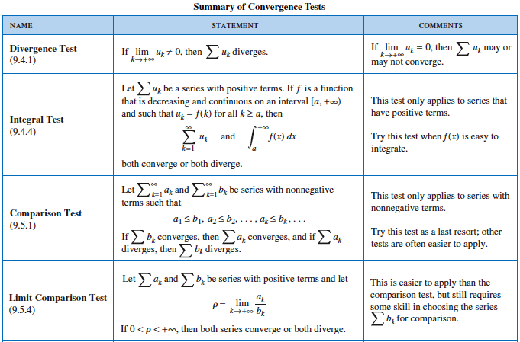
fhs

Slide 26
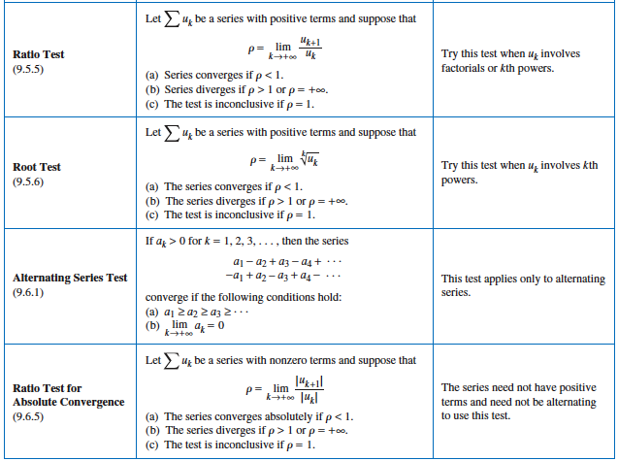
fsh

Slide 27
Squaw Valley Christmas

